Slide 1
Wireless Network Overview
Slides originally from Carey Williamson and David Schwab
Notes derived from “Computer Networking: A Top Down Approach”, by Jim Kurose and Keith Ross, Addison-Wesley.
Slides are adapted from the book’s companion Web site, with changes by Anirban Mahanti and Carey Williamson.

Slide 2
What Is Wireless Networking?
The use of infra-red or radio frequency signals to share information and resources between devices
A hot computer industry buzzword:
  Lots of advertising by companies and media
  Wireless Broadband, 3G wireless, WAP, iMode, Bluetooth
Mobile Internet, Pervasive Computing, M-Commerce
  Ubiquitous?
  Global?
  Revolutionary?
Notes:
“Think, Bill, Think”

Slide 3


Two Popular 2.4GHz Standards:
IEEE 802.11
  Fast (11B)
  High Power
  Long range
  Single-purpose
  Ethernet replacement
  Easily Available
    Apple Airport, iBook, G4
    Cisco Aironet 350
Bluetooth
  Slow
  Low Power
  Short range
  Flexible
  Cable replacement
  “Vapourware”
    Anoto, Test cards, phone
Notes:
Take a closer look at 802.11, and the technology underlying it.
802.11 = 10baseT replacement
Bluetooth = USB replacement
Talk about Bluetooth later in lecture.

Slide 4
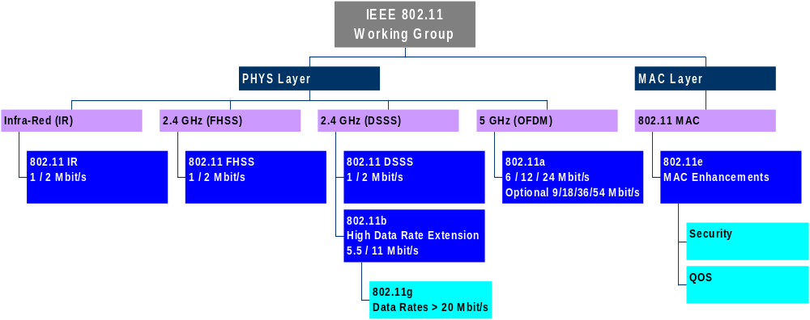
IEEE 802.11 Organization Tree:
Notes:
OFDM = Orthogonal Frequency Division Multiplexing
MAC = Medium Access Control

Slide 5
Pros and Cons of 802.11:
Pro:
  High bandwidth (up to 11 Mbps)
  Two modes of operation: infrastructure vs. ad hoc
Con:
  Incompatibility between old and new cards
  Signal blocked by reinforced concrete or tinted glass
  High channel BER can degrade performance (lots!)
  No standard for hand-off between base stations
  Some channel numbers overlap spectrum
  High power consumption in laptops
Notes:
Older devices DHSS, new devices DSSS. Old DSSS limited to 2 Mbit/s
The high power consumption severely limits battery life. For this reason, few 802.11 cards are available for handheld devices.
Different base stations incompatible.
Peer-to-peer and Client-Gateway connections only – no Multi-Hop

Slide 6
Multi-Hop Ad Hoc Wireless Networking
Routing protocols used to improve wireless connections
Infrastructure-free, dynamic
True Peer-to-Peer routing
Fault tolerant
Examples: DSDV, TORA, DSR, ...
Notes:
Users allowed free movement
Peers do not have a central database, gateways act as peers
Transparently re-route packets if destination not found
Easier installation of new computers
More overhead – route discovery, updates
Requires intelligent protocols
Must accommodate lossy connections, handoffs, restricted bandwidth, interference, disconnections

Slide 7
Bluetooth
Think USB, not Ethernet
Created by Ericsson
PAN - Personal Area Network
  1-2 Mbps connections
  1600 hops per second FHSS
  Includes synchronous, asynchronous, voice connections
  Piconet routing
Small, low-power, short-range, cheap, versatile radios
Used as Internet connection, phone, or headset
Notes:
Three-in-one-phone: When at home, use home gateway, when on road use cell tower, act as walkie-talkie when near enough.
Internet connection: When at home, use home gateway. When on road use cell phone. When in office, use office gateway.
Ultimate Headset: Computer, cell phone, telephone gateway, CD player, Discman, etc.

Slide 8
More Bluetooth
SIG: Special Interest Group
  http://www.bluetooth.com
  2164 member companies
  Including 3Com, Ericsson, IBM, Intel, Lucent, Microsoft, Motorola, Nokia, Toshiba, etc.
  Bluetooth Specification (v1.1)
Trouble:
  Not an Ethernet replacement
  Incomplete specification
  Incompatible implementations
  Delayed products, low demand
Predictions still optimistic
Notes:
Problems:
Bluetooth has been mis-labelled by many journalists and companies as being a wireless networking technology.
The connection sequence described in the specs is very rough. No description of how a piconet organizes itself.
Each company wants their products to work only with products from the same company
Tests are being run on products to ensure compatibility. Bluetooth sales predictions are still very high (millions of phones by end of 2002).

Slide 9
Security
Wireless sniffers
IEEE 802.11:
  ESSID – Extended Services Set ID
  WEP – Wired Equivalent Privacy
    40 bit RC4 (RSA) encryption
Bluetooth Security
  Rapid hop sequence
  Short range
  Encrypted transmissions
Notes:
The ESSID is needed to connect to a given 802.11 network. Connections can also be restricted by MAC address, although this is less reliable.
Some vendors offer higher levels of encryption. Other vendors do not even implement WEP level security.
Resurrecting Duckling – imprinting, resurrecting, sleep-deprivation attacks.
Bluetooth devices switch frequencies 1600 times every second. They also limit their output power to a minimum, making eavesdropping very difficuly.

Slide 10
Guerrilla.net
An underground alternative to the wired Internet
A grassroots movement established in 1996
  802.11 Wireless LAN cards
  Roof mounted antennae
  Free software (FreeBSD)
Multi-hop routing, Internet connectivity
About $800 per node
Other networks popping up in SF, Seattle, London
Notes:
From Consume.net: “Fed up with being held to ransom in the local loop, phased by fees to ISP's, concious of community? OK so lets build a fresh network, one that is local, global, fast, expanding, public and user-constructed.”
Co-operating ISP’s offer high speed internet.
Legal issues covered by agreement.
Lobbying the FCC for spectrum allocation for non-profit telcos.
Dubbed “Free-network” movement – similar to free software, Napster, internet itself.
Price is 1/3 what it would have been a couple years ago.
Pulling antennae from Apple computers
Catching on:
SFLan, San Fransisco
Consume.net, London
Seattle Wireless, Seattle
Problems: Scalability, abuse, tragedy-of-the-commons, no quality-of-service guarantee (same complaints made about TCP/IP)

Slide 11
Future of Wireless
Better simulations + movement models
Better security
Wider selection
Lower prices
Less configuration required
More end-user focus
Better software
Less visible
More popular
Notes:
Simulators with signal fade, movement models with groups.
High levels of encryption, faster hopping / longer chipping keys
More computer vendors will ship w/ 802.11 cards or Bluetooth (IBM, Compaq).
Apple likely to lead the push for Bluetooth (after USB, Firewire, 802.11 success).
Currently: buy network card, configure network, add clients
Tomorrow: built-in card, plug and play configuration, clients perform resource discovery – Grandma-level wireless
Software: Better drivers, better media streaming, better routing
- Maxwell Dworkin building in Harvard.

